Slide 1
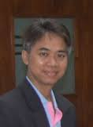
Mathematics Education for Future Prediction:
The APEC Project on 2015
What do you want to do next?
We would like to share the vison for our future mathematics education based on the past experience of the APEC project.
What we did?
Masami Isoda PhD & h.c PhD,
Professor of Mathematics Education
CRICED, University of Tsukuba, Japan.
Project Overseers, APEC Lesson Study Project.

Slide 2
How many percent of children who are coming into school get the jobs in future which are not existed at the era?
How do you esitimate?
Is it scientific?
http://opinionator.blogs.nytimes.com/2011/08/07/education-needs-a-digital-age-upgrade/?_r=0

Slide 3
Really? Good News!?
Why we use the ranking for comparison?
Why we do not consider the distribution?
Strange!
On the site, the ranking changes every year?
Why Mathematics?

Slide 4
How do you think?
Construct viable arguments and critique the reasoning of others

Slide 5
Reforms in USA
Principles and Standards for School Mathematics (NCTM, 2000)
    problem solving, reasoning and proof, communication, representation, and connections
Common Core State Standards for Mathematics (2010)
    1. Make sense of problems and persevere in solving them. 2. Reason abstractly and quantitatively. 3. Construct viable arguments and critique the reasoning of others. 4. Model with mathematics. 5. Use appropriate tools strategically. 6. Attend to precision. 7. Look for and make use of structure. 8. Look for and express regularity in repeated reasoning.
Why we have to objectify the process/practice as a part of teaching content?
Why we need the reform?
Is it really new?

Slide 6
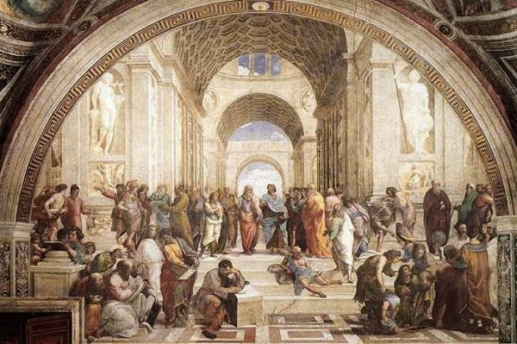

Slide 7
Contents and Conclusions:
Invariance / Immutability: 不易
Human Character Formation
Mathematical Thinking and Attitude
Mathematical Graces to see the world
Mathematization, Math Inquiry / Activity
Emphasis / Reform Theme: 流行
Competency for:
  Finding the Unknown Variables on the Situation
  Using Unknown V. for Changing Settings of the Situation
Competency for Plausible Reasoning:
  Depending on the Context for Saying A and non A
  Planning the possible scenario for the better future
Let’s work together for producing future scenario!
  What mathematics are necessary for future preparation?
  New issues beyond old fashioned mathematical modeling.
  How do you produce the future scenario?
Through verbalizing, we can enlarge the objective of mathematics education for human enter prize.
Verbalizing for clarifying the objective of teaching is not necessary the same as producing the theoretical terms for clear observation.
Lesson Study is the activity to verbalize the objective of (mathematics) education
What is Math Education for Future such as 21st C. Skills

Slide 8

Which one?
Ａ

Slide 9
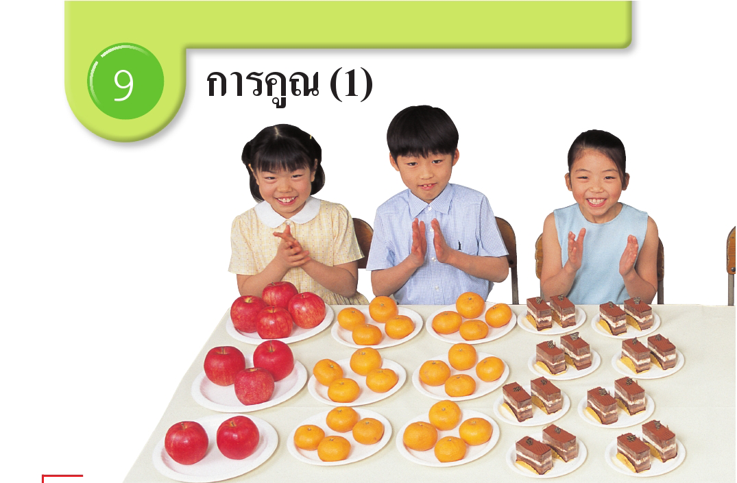
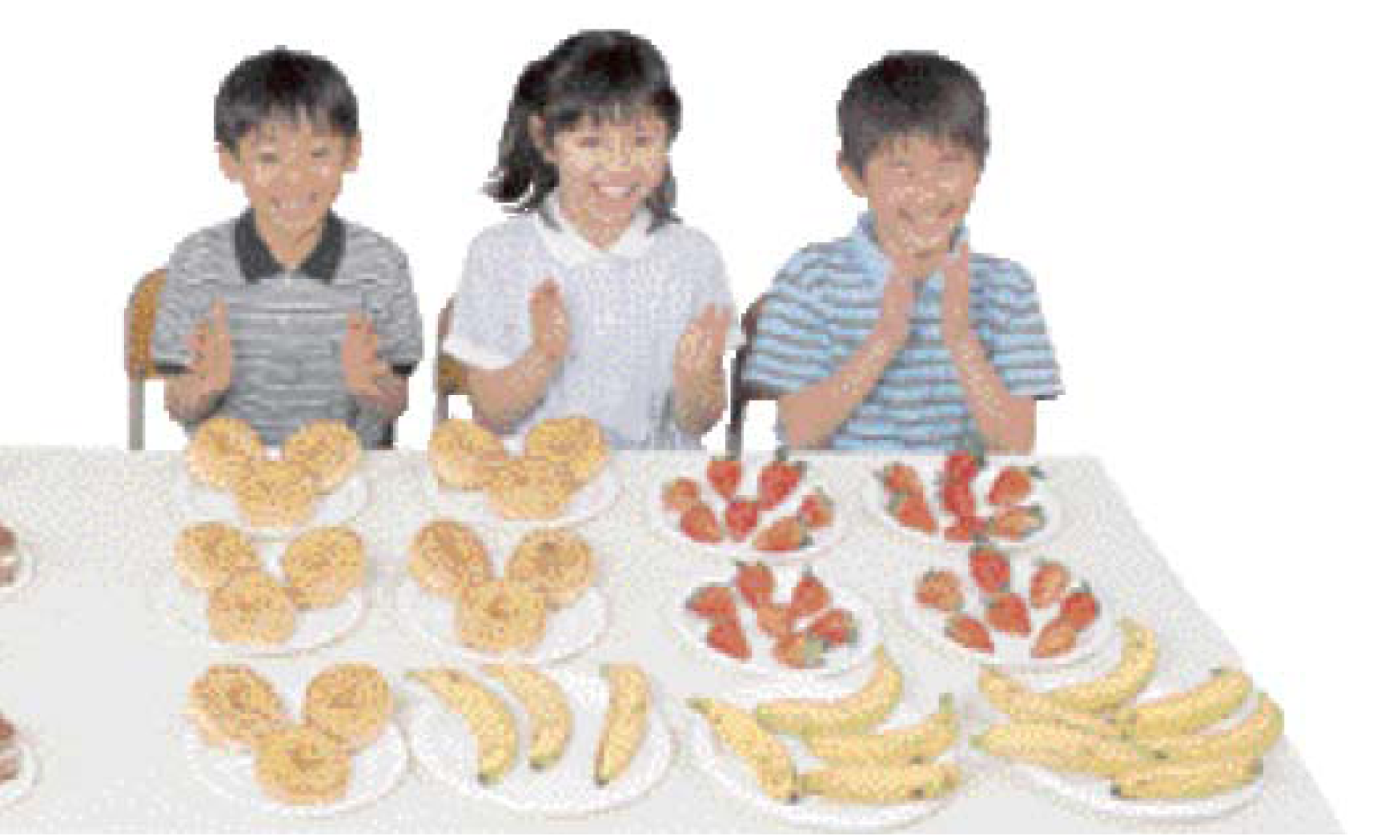
Textbooks
Why there are apple and banana?
For learning A, we should know non A.
Developing the idea of unit

Slide 10
Achievement of Thailand
How Many?
By Inprasitha,M. , Isoda,M. & Sudejamnong

Slide 11
Procedurization of Concept
Conceptualization of Procedure on the Extending Curriculum Sequence
(Theory by Isoda,1991,1996,1998,2005,2008a,2008b,2013)
More General Case
Meaning of C
Division of Frac.
Procedure of C
2÷3＝2×1／3
General Case
Meaning of B
0.3times
Procedure of B
0.3x2
Special Case
Mathematization
Meaning of A
2+2+2: 3times2
Procedure of A
3x2

Slide 12
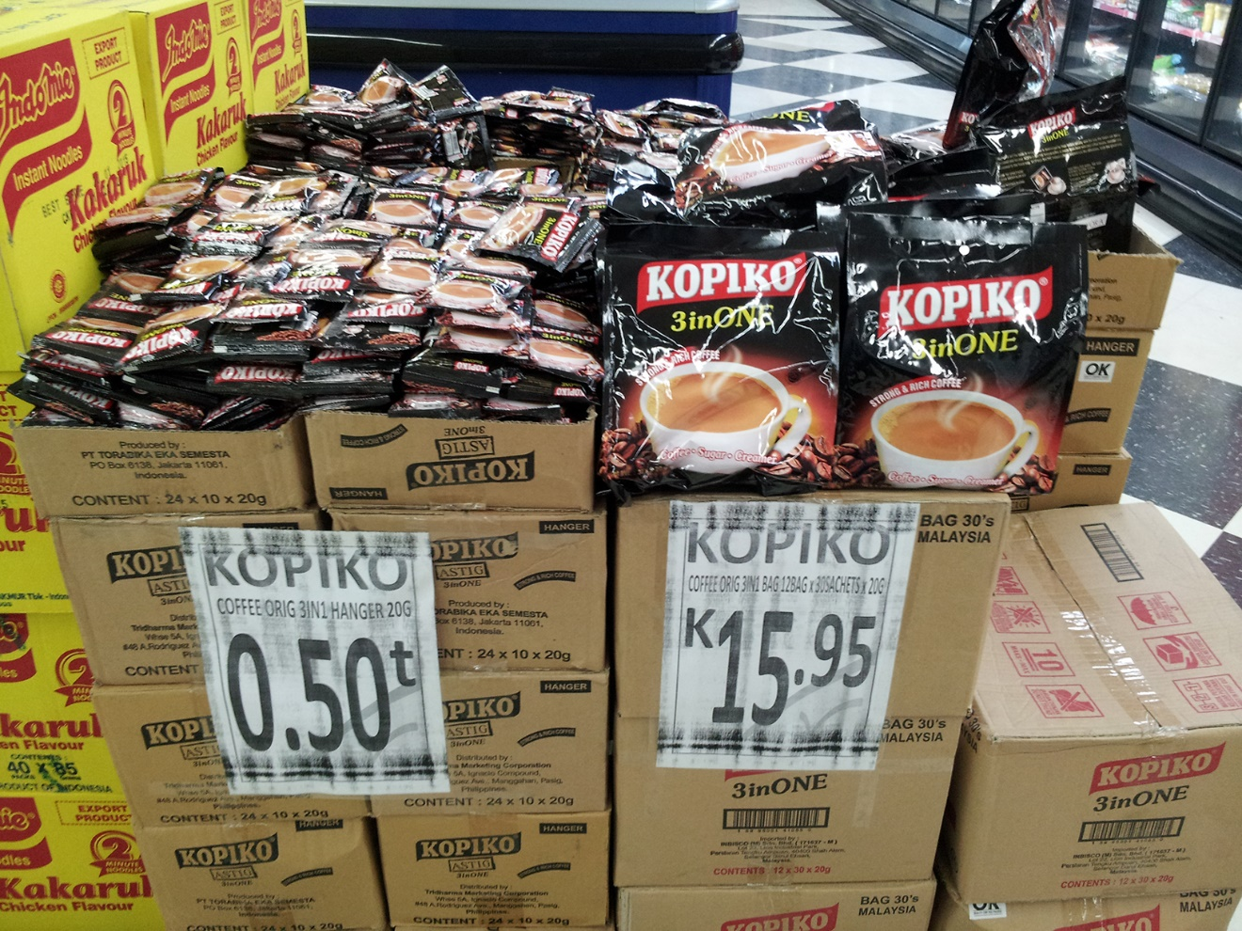
How do you think?
30 pieces in a pack
Each coffee piece
What is the numeracy, here?
Why we need numeracy?

Slide 13
Just Simple Arithmetical Progression
What is the competency, here?
http://math-info.criced.tsukuba.ac.jp/museum/dbook_site/Lectures-Samples-pub/files/EText.html

Slide 14
Emergency Preparedness Education with Mathematics
Monica Miyagui http://math-info.criced.tsukuba.ac.jp/museum/dbook_site

Slide 15
Objectives/Aims of Education
Developing Children Who Lean Math by and for Themselves: We should develop children who can use what they leaned before without our support. If they developed, they can reply the question what do you wan to do next.
Human Character Formation
Attitude and Values: Beautifulness, Curiosity, Reasonableness, Appreciation
Thinking Skills for Learning: Learning How to Learn!
Mathematical Thinking in General:
Extension, Generalization, Anticipation, Integration, Change the representation for explaining
Knowledge and Skills
Traditional ways of calculation
New ways of calculation and Patterns
Thinking with using Mathematical Concepts

Slide 16
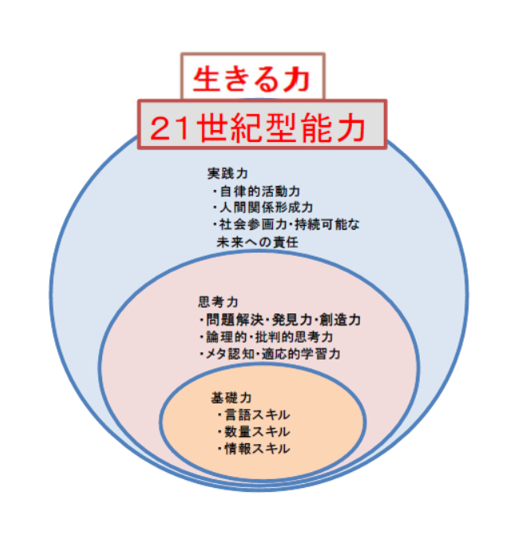
国立教育政策研究所
2012
Zest for living; 21st century competency/skill
Practical skills
> Autonomous Force
> Human Relationship Formation
> Social Participation, Commitment for Sustainable Development
Thinking Skills
>Problem Solving, Creativity
>Logical and Critical Thinking
>Meta Cognitive and Adaptive
Basic Skill
> Language Skill
> Mathematics Skill
> Informatics Skill

Slide 17
Contents and Conclusions:
Invariance / Immutability: 不易
Human Character Formation
Mathematical Thinking and Attitude
Mathematical Graces to see the world
Mathematization, Math Inquiry / Activity
Emphasis / Reform Theme: 流行
Competency for:
  Finding the Unknown Variables on the Situation
  Using Unknown V. for Changing Settings of the Situation
Competency for Plausible Reasoning:
  Depending on the Context for Saying A and non A
  Planning the possible scenario for the better future
Let’s work together for producing future scenario!
  What mathematics are necessary for future preparation?
  New issues beyond old fashioned mathematical modeling.
  How do you produce the future scenario?
Through verbalizing, we can enlarge the objective of mathematics education for human enter prize.
Verbalizing for clarifying the objective of teaching is not necessary the same as producing the theoretical terms for clear observation.
Lesson Study is the activity to verbalize the objective of (mathematics) education

